Slide 1
Directed Graphs:
Part B: Fully dynamic exact all-pairs shortest paths

Slide 2
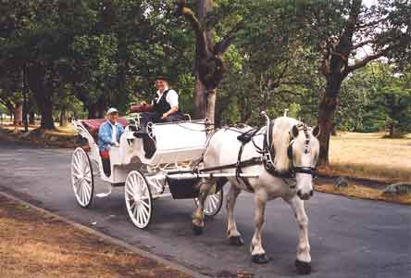
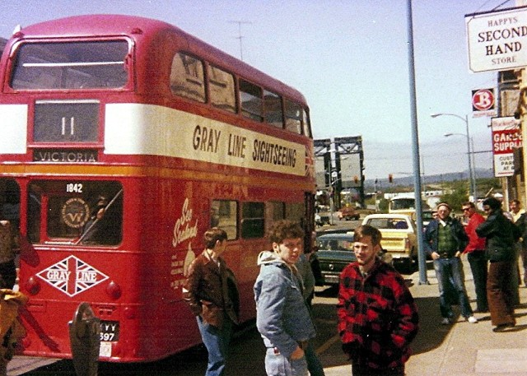
Directed graph problems
What is distance from A to F? or Update: Insert/delete all edges incident to a single node.
7
A
F
5.73

Slide 3
Fully dynamic exact all pairs shortest paths. Incremental in O($n^{2}) per insertions (Floyd Warshall 1962)$ Fully dynamic for positive weigihts in O(n² log³n) amortized update time (Demetrescu, Italiano 04) Fully dynamic for real weights in O($n^{2}$ (log n + $\log^{2}{m/n}$) amortized time. (Thorup SWAT 2004). Fully dynamic for non-neg wts in Õ($n^{2.75}$) worst case time. (Thorup STOC 2005)

Slide 4
INCREMENTAL (insertions or weight decreases)
7
v
8

Slide 5
INCREMENTAL (insertions or weight decreases)
A
5
X
v
Y
6

Slide 6
We can assume shortest paths are unique
If not, compare extended weight of path where ew(path)= (w(path), ID(path))
ID(path) =u + nv if path is an edge u,v)
ID(path)=max(ID(l(path), r(path))
Compare weights of paths lexicographically
Prove that each path has unique weight by induction on length of path

Slide 7
Properties of shortest paths when the shortest paths are unique

Slide 8
Definitions of paths
DEF: selected paths (“Zombies” )
A path in G which was identified as a shortest path at some (previous) time
DEF: locally selected paths
A path is locally selected if, no matter which endpoint is removed, the resulting path is a selected path. A vertex is locally selected
DEF: alternative paths to P
A selected path between the same endpoints

Slide 9
IDEA: New shortest paths are extensions of locally selected paths

Slide 10
Properties of shortest paths (assume unique)
X= {Paths which are locally selected which are shorter than any selected alternatives}
Lemma:
If a shortest path Q is not selected yet, it has a subpath in X, →, if X is empty, Q is selected.
Proof: Pick its minimal non selected subpath

Slide 11
X= {Paths which are locally selected which are shorter than any selected alternatives}
1.If a shortest path Q is not selected yet, it has a subpath in X,
2. If P has minimal length in X, then P is a shortest path
Proof of 2 : If it isn’t, there’s a non-selected shorter path Q with a subpath in X which must be shorter
(non-neg edge weights), contradicting P’s minimality

Slide 12
Determine paths s ->t which are in X
Alg: For each pair of nodes (s,t) keep priority queue
min
s,t
Locally selected paths from
s --> t, short alternatives

Slide 13
Lemma : After an update, if P is a shortest of all paths in X, it is a shortest path
min = shortest path
Alg: For each pair of nodes (s,t) keep priority queue
Use newly selected
Shortest
Paths to form new
Locally selected.paths
(for other
pairs)
Global heap
min
s,t
Insert new edge
Locally selected
paths from s --> t

Slide 14
Representation of paths in system
P=Path (x,a,…b,y) = Ptr to r(P)= Path(a,..y)
Ptr to l(P)=Path(x,…,b)
weight(P)
With each path P, also keep two lists:
L(P)={path in system of the form (u,x)P
R(P)={path in system of the form P(y,w)

Slide 15
CLEAN UP (v): remove all system paths containing v
Remove every edge in system containing v;
Repeat until no more paths removed:
If any path P is been removed, remove every path in extensions of P, i.e., L(P) and R(P)

Slide 16
FIX UP (v): restore all system paths containing v
Remove every edge in system containing v;
Phase 1:
Reset weights of edge (u,v) or (v,w) which have changed.
Add (u,v) to Heap (u,v), to L(r((u,v)) and R(l(u,v))
Phase 2: Initial global queue with min .wt. paths for each pair (x,y)

Slide 17
FIX UP (v):
Phase 3: Extract path P =x,a..b,y from global heap
Check if x->y has already been extracted;
if not this is shortest path
Then
Add path to L(r(P)), R(l(P))
MAKE NEW locally selected paths:
for each (x’,x)x→b in L(l((P)), form (x’,x)P
for each a->y’ in R(r(P)), form P(y,y’)
ADD to appropriate Heap as soon as discovered

Slide 18
Problems: too many changes
Static case: there can be O(n³ ) paths created if all shortest paths are generated from scratch
If only current shortest paths are kept they can all be killed and need to regenerated.
Alternatively, if all old shortest paths kept, a
sequence of insertion/deletions can cause
O(n³) changes in locally selected paths repeatedly.

Slide 19
Problems: too many changes

Slide 20
Problems: too many changes

Slide 21
Problems: too many changes

Slide 22
Problems: too many changes

Slide 23
Problems: too many changes

Slide 24
Problems: too many changes

Slide 25
Problems: too many changes
Static case: there can be O(n³ ) paths created if all shortest paths are generated from scratch
If only current shortest paths are kept they can all be killed and need to regenerated.
Alternatively, if all old shortest paths kept, a
sequence of insertion/deletions can cause
O(n³) changes in locally selected paths repeatedly.
Demenstrescu Italiono Solution: keep some old paths in queues but
deselect periodically--complicated

Slide 26
Reducing system paths. (Italiano, Demestrescu)
Let t be the last time v was updated
Delete v and reinsert v at times $2^{i}$for i=1,2, … after v was inserted.→ log n “dummy” updates

Slide 27
These dummy updates result in $≤\log{n}$ selected paths x→y
More properties of paths
Order them by time they were formed.
These times must have been 1, 2, 4,… n in the past.

Slide 28
Lemma:
If there are z selected paths between any pair of vertices, then there are at most O(z$n^{2}$) locally selected paths containing v
Proof:
CASE: if v is an endpoint, then there are zn choices for the next to endpoint.
CASE: if v is not an endpoint, (s,v) and (v,t) are selected so there is only z choices for each pair.

Slide 29
→Each update destroys O(z$n^{2})$locally selected paths
Lemma: $≤mn$ locally selected paths in the graph, since m start edges
Then after m/n updates, can’t create an average of more than z$n^{2}$ locally selected paths per update.

Slide 30
Inserting a sequence of vertices vertex creates O($n^{2}$) locally selected paths per vertex inserted
INCREMENTAL
Proof::
Then there are no selected paths containing v and so no more than O($n^{2}$) $locally selected paths are created,$
$$by the Lemma$$

Slide 31
Thorup’s approach: Decremental + rebuild
A shortest path remains shortest until its vertex is deleted
So all selected paths are shortest→1 per pair x→y
Lemma → O($n^{2}$) paths destroyed per vertex update.

Slide 32
Decremental to Fully dyn. Let t=number of insertions Reinitialize data structure on level i when the index of the least significant of t number of insertions =$i$ All insertions done since the last bigger rebuild was done are considered “centers” with level i.

Slide 33
How to do a rebuild
On level i, only keep selected and locally selected paths which contain level I centers
Analysis: $≤2^{i} centers −→ ≤2^{i}n^{2}$ system paths inserted. Deletions cost $n^{2} each$
Amortized against #insertions

Slide 34
View of Global system
Global priority queue used to select shortest paths

Slide 35
Analysis
$≤2^{i} centers −→ ≤2^{i}n^{2}$ system paths inserted. Deletions cost $n^{2} each$
Vertices deleted from up to log n data structures.
So #paths = $n^{2}\log{n}$ per vertex
Total cost = $n^{2}\log^{2}{n} per vertex$

Slide 36
Worst CaseÕ($n^{2.75}$)
Use decremental with
Floyd-Warshall for insertions and rebuild
every now and then
Rebuilding has to be done gradually --not straightforward

Slide 37
Directed Graphs
Open Problem:
- -Closing gap between worst case O (n^{2.75} )(Thorup)
and amortized O(n² log²n).
Tradeoffs, lower bounds

